Slide 1
Brain graphs of Women and Men
Balázs Szalkai, ELTE Institute of Mathematics

Slide 2
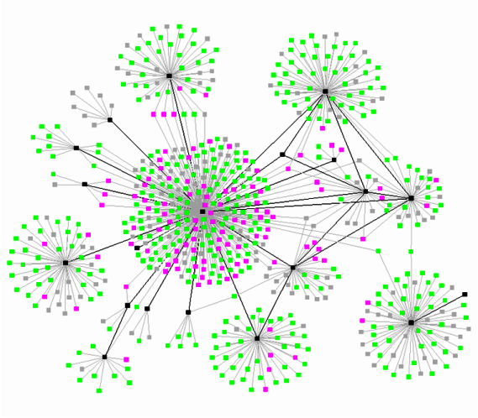
The brain from a mathematical point of view
Connectome: nodes=neurons, edges=axons

Slide 3
The brain from a mathematical point of view
Macro-scale connectome: nodes=ROIs (regions of interest), edges=axons

Slide 4
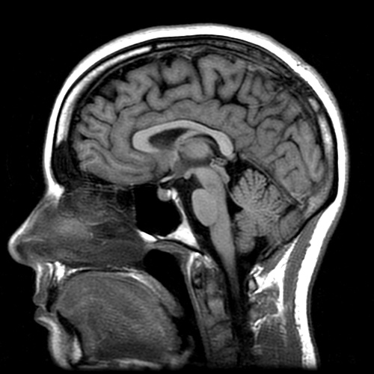
Computing a macro-scale connectome
Diffusion MRI scan
Segmentation
Parcellation
Tractography
Graph construction

Slide 5
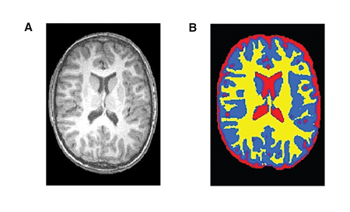
Computing a macro-scale connectome
Diffusion MRI scan
Segmentation
Parcellation
Tractography
Graph construction

Slide 6
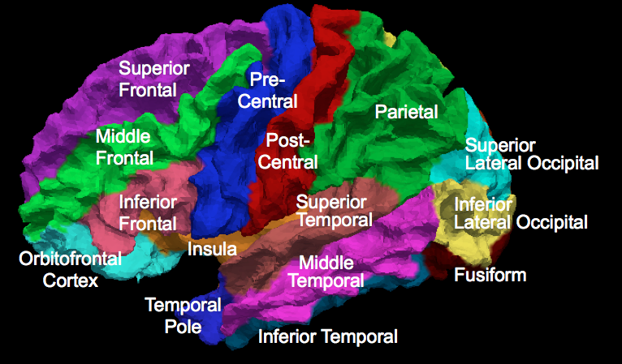
Computing a macro-scale connectome
Diffusion MRI scan
Segmentation
Parcellation
Tractography
Graph construction

Slide 7
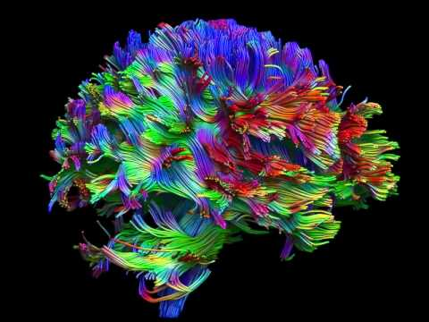
Computing a macro-scale connectome
Diffusion MRI scan
Segmentation
Parcellation
Tractography
Graph construction

Slide 8
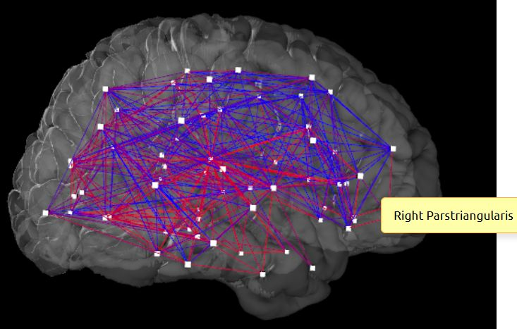
Computing a macro-scale connectome
Diffusion MRI scan
Segmentation
Parcellation
Tractography
Graph construction

Slide 9
Materials and Methods
Human Connectome Project
Healthy male and female subjects, age 22—35
96 subjects (52 females and 44 males)
83, 129, 234, 463 and 1015-node resolutions
5 different weight functions
Mathematical analysis

Slide 10
What we know about brain and gender
Females have…
smaller brains
larger gray/white ratio
larger cortical thickness and cortical complexity
Hippocampus and amygdala
Homosexuality and brain characteristics of the opposite sex (Savic, Lindström 2008)

Slide 11
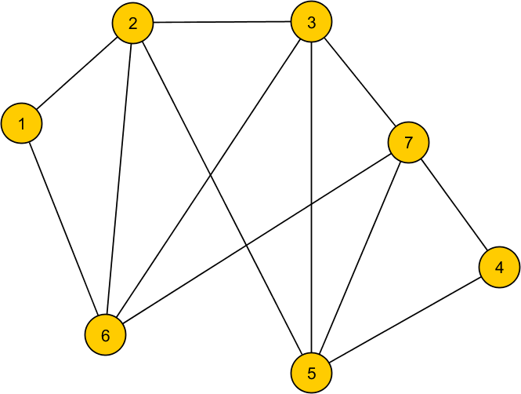
Our results
Women’s brains…
…have more edges on general
Denser network

Slide 12
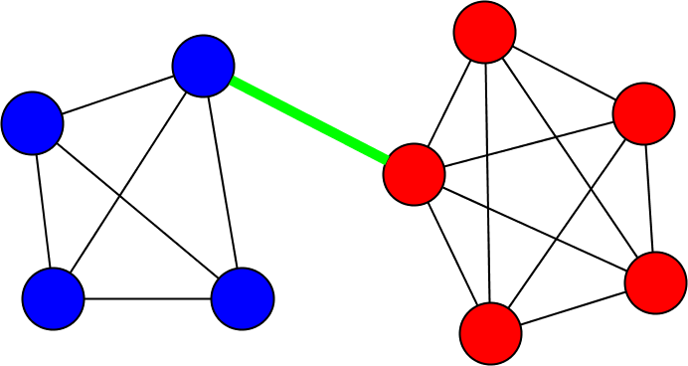
Our results
…have a larger minimum bisection width
The minimum bisection ≈ separates the 2 hemispheres

Slide 13
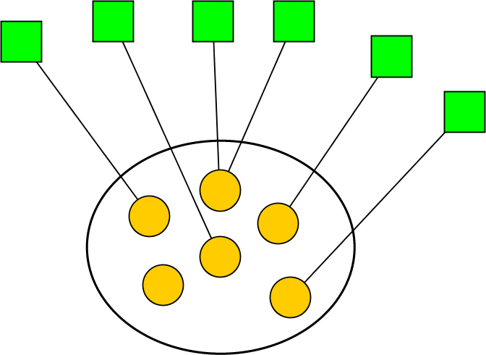
Our results
…are better expander graphs
Node groups have more neighbors

Slide 14
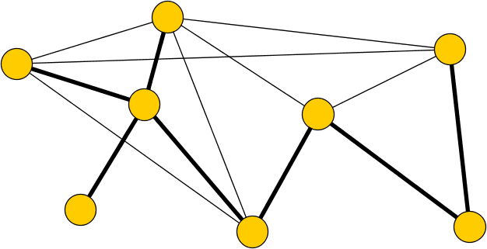
Our results
…have more spanning trees

Slide 15
Conclusion
First application of graph theory on brain graphs
(as opposed to network science)
Women’s brain graphs: denser and more effective networks
Not explained solely by the physical size of the brain

Slide 16
Thank you for your attention!
Szalkai B, Varga B, Grolmusz V (2015) Graph Theoretical Analysis Reveals: Women’s Brains Are Better Connected than Men’s. PLoS ONE 10(7): e0130045.doi: 10.1371/journal.pone.0130045

